Slide 1
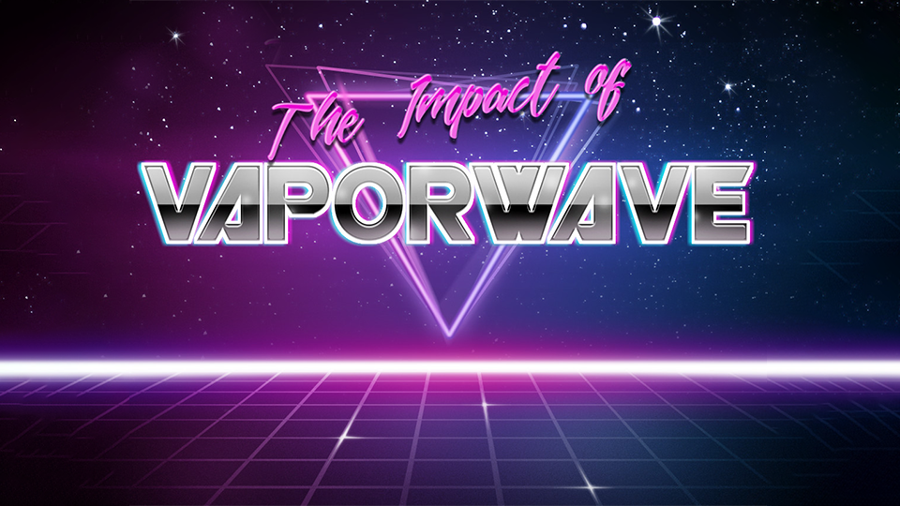

Slide 2
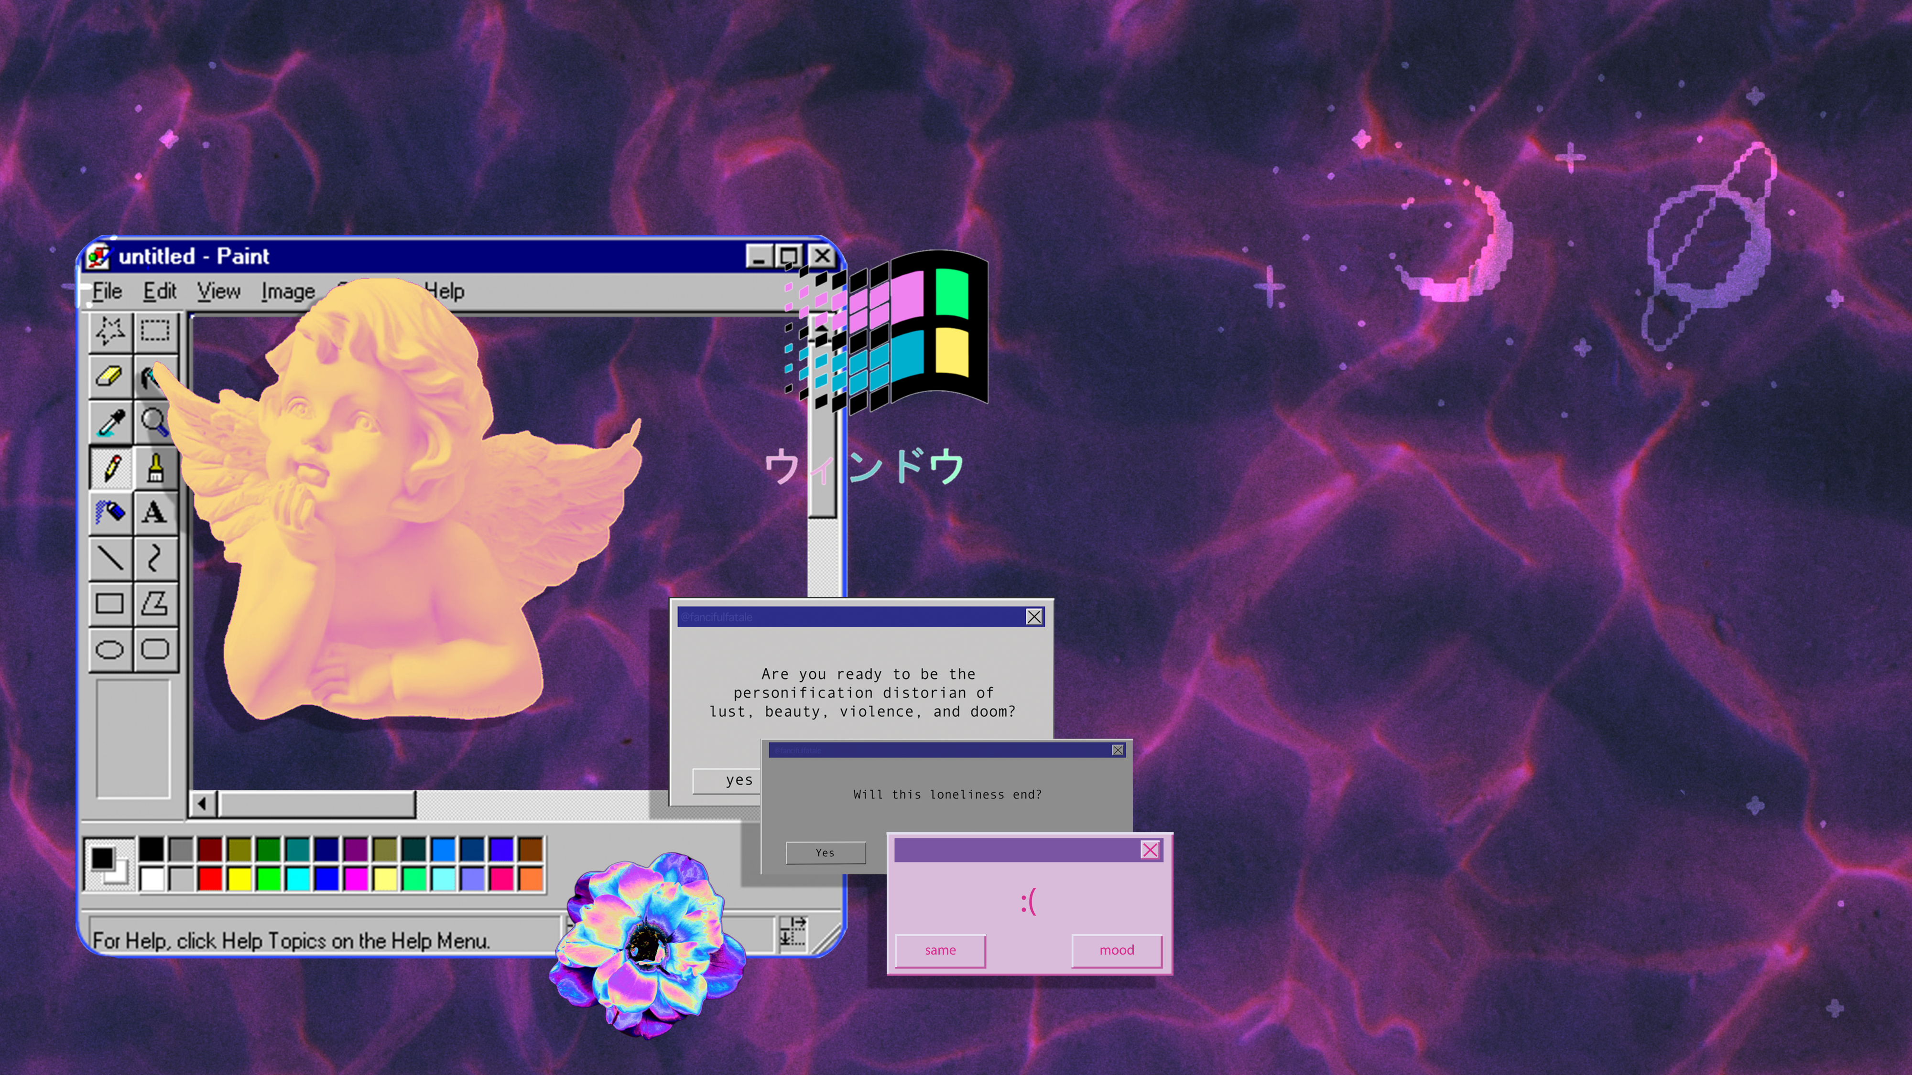


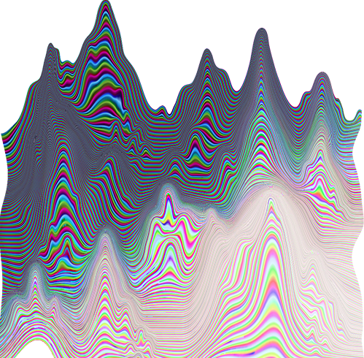
TABLE OF CONTENTS
TABLE OF CONTENTS
01
WHAT IS VAPORWAVE
02
AESTHETIC CHOICES
03
CULTURAL IMPACT

Slide 3
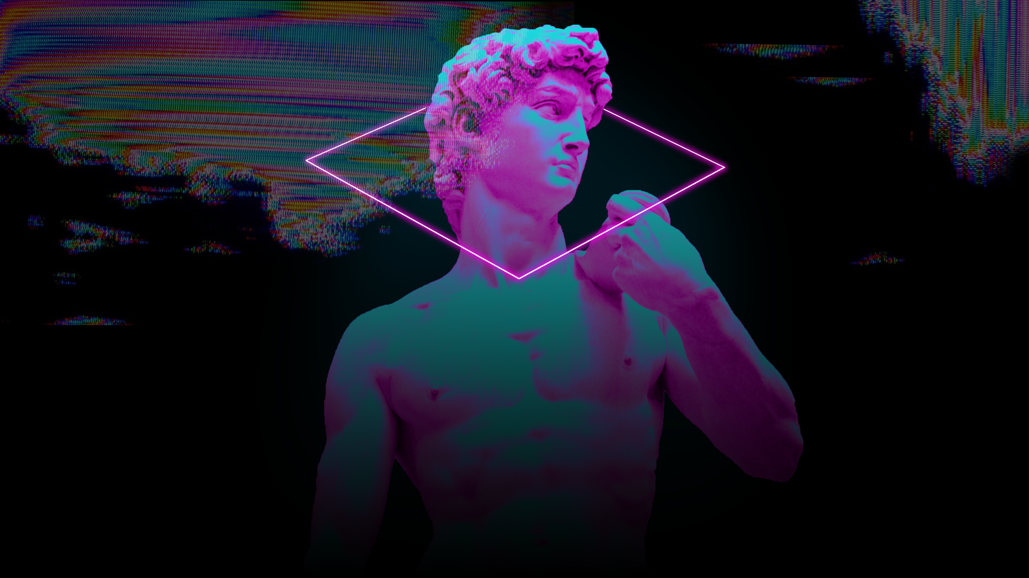
What
Vaporwave
Is
Vaporwave is a microgenre of electronic music, a visual art style, and an Internet meme that emerged in the early 2010s. It is defined partly by its slowed-down, chopped and screwed samples of smooth jazz, elevator, R&B, and lounge music from the 1980s and 1990s.
The surrounding subculture is sometimes associated with an ambiguous or satirical take on consumer capitalism and pop culture, and tends to be characterized by a nostalgic or surrealist engagement with the popular entertainment, technology and advertising of previous decades.

Slide 4
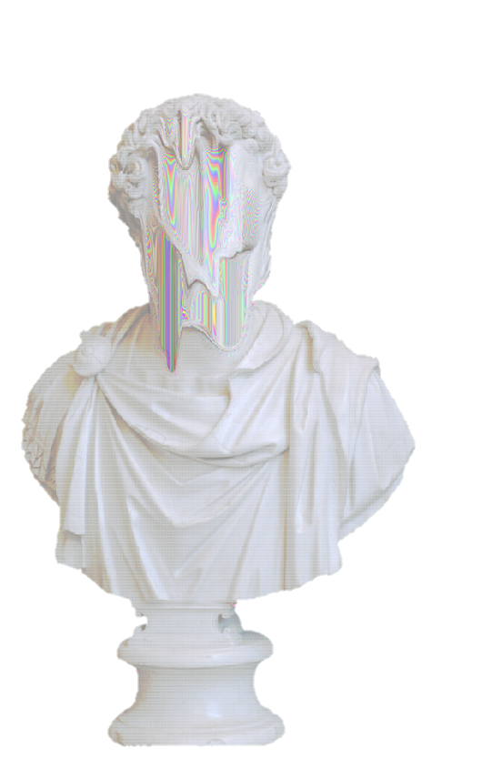

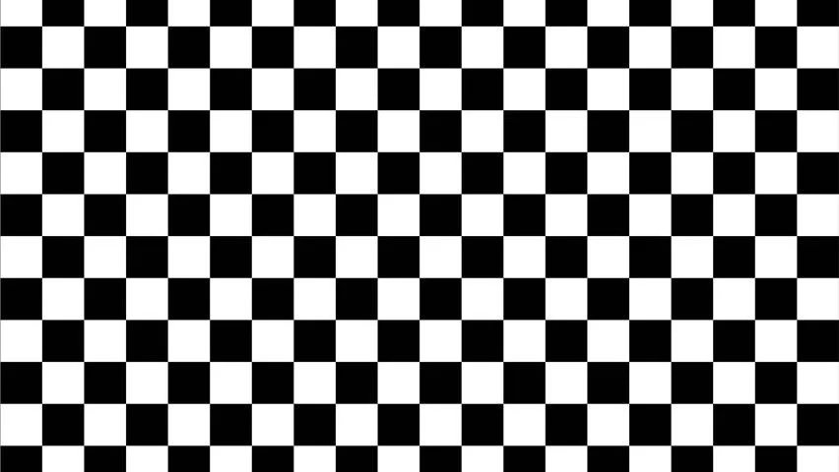
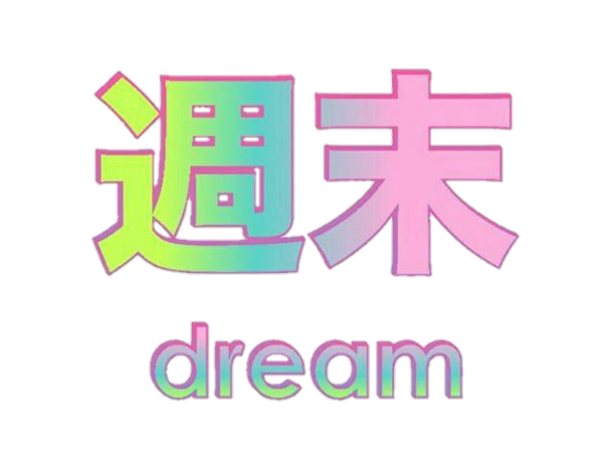
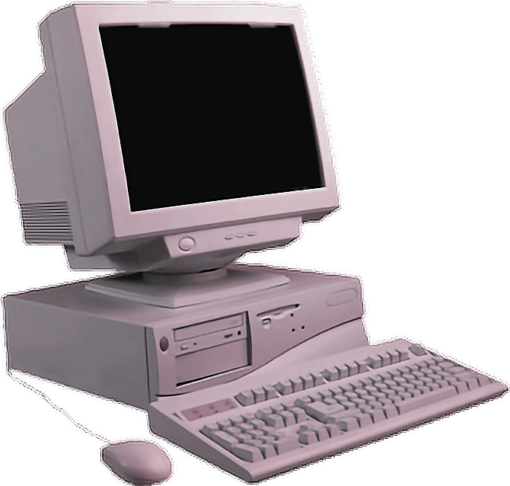
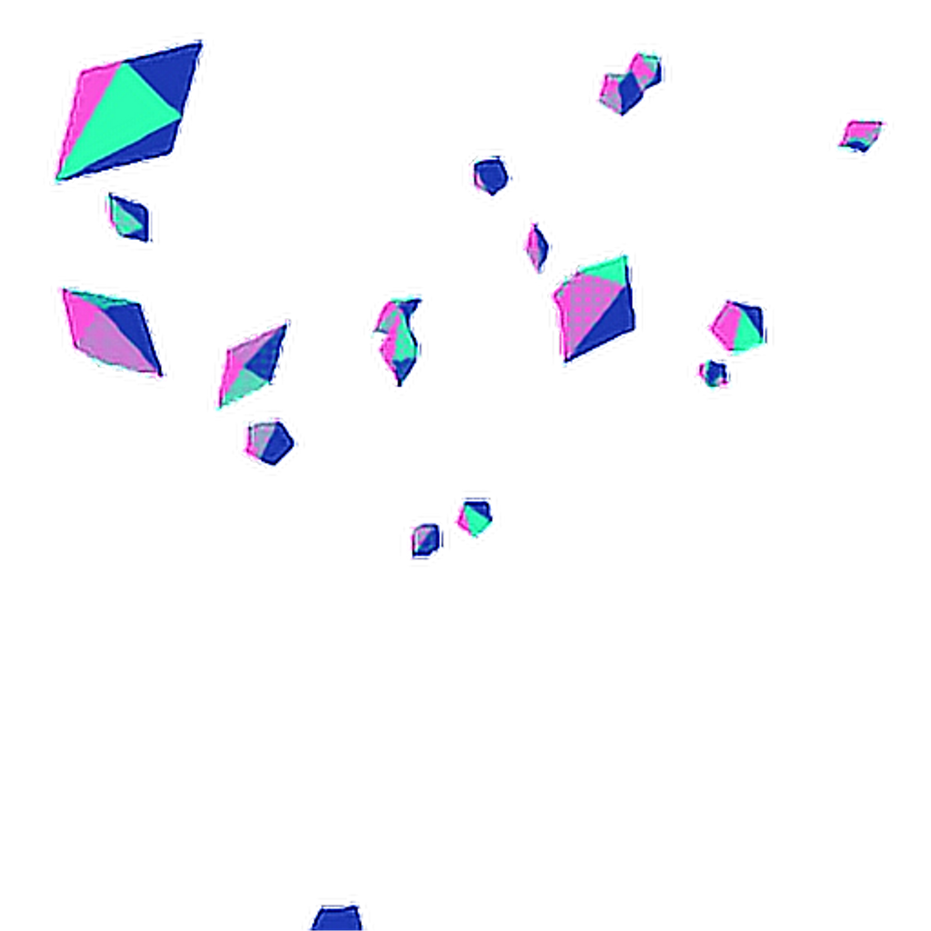
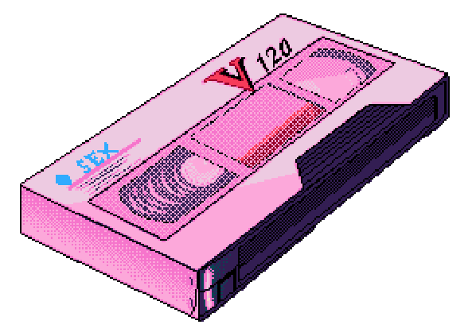


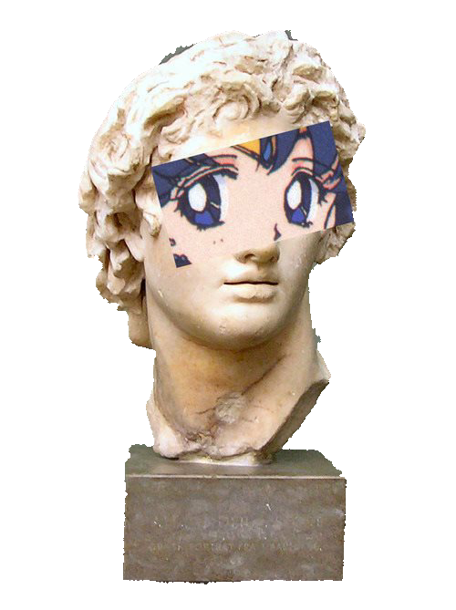



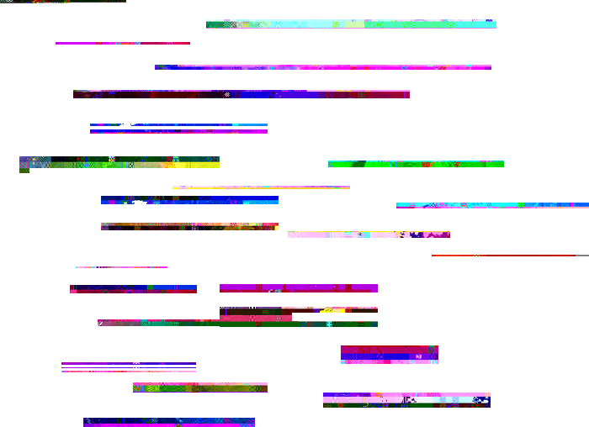
Darker base tone + neon | colours | 90’s inspiration | Surrealistic vibe and images | Memes | synth | Technology | Greek statues | Japanese text | Glitch art

Slide 5
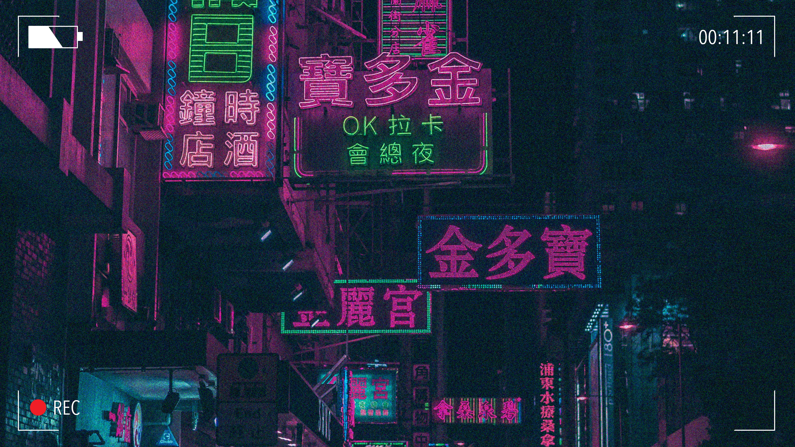
Ｃｕｌｔｕｒａｌ Ｉｍｐａｃｔ
亜アし
Birthed genres; Electro-Clash, Nu-Rave, Chillwave
Accessibility to affordable electronics
Freedom of expression
Room for evolution and growth
Powerful movements ex. anti capitalism
Hollywood ex. Blade Runner (1982 and 2017)
“
…allowed millennials to produce a kind of music that once seemed rebellious and almost punk in its aesthetic and attitude…
”

